Slide 1
HRM Issues
Chapter 10

Slide 2
Legal Issues
Difficult area to legislate clearly
Political battle ground
More attention paid to the rights of individual employee – HRM need to comply with anti discrimination legislation

Slide 3
HRM At work
ensuring that recruitment, selection and promotion procedures comply with anti-discrimination legislation;
staff training and development;
setting up and monitoring remuneration(salary) policy;
setting up and monitoring appraisal(assessment/evaluation) procedures;
administering dismissal and redundancy procedures(procedure to let go someone when they are unnecessary/not needed anymore);
dealing with contracts of employment;
workforce planning;
administering grievance(complaint) procedures;
being aware of new legislation affecting employment rights and advising management of what the organization must do to comply with it;
dealing with health and safety;
administering consultative committees.

Slide 4


HR Process
Acquisition
Fairness
Training
Health and Safety
Appraisal
Labor Relations
Compensation

Slide 5




Recruiter
EEO(Equal Economic Opportunity) coordinator
Training specialist
Human Resource Specialties
Labor relations
specialist
Job analyst
Compensation manager

Slide 6

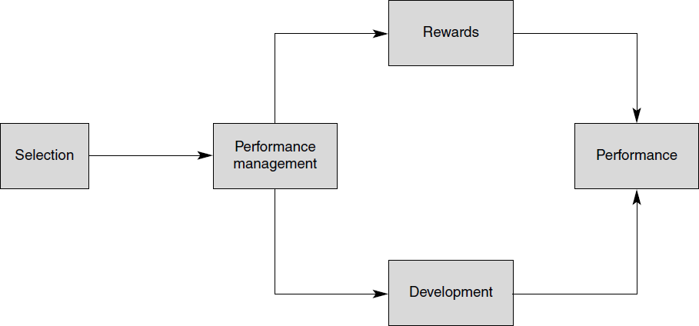

Slide 7
Recruitment and Selection
Recruitment – selection
Recruitment is the process of identifying and attracting potential candidates for job vacancies within an organization.
Selection, on the other hand, is the subsequent stage where the employer assesses and chooses the most suitable candidate for the position. It involves making decisions about which candidates will be offered the job.
Outsourced to agencies
Some companies choose to outsource their recruitment process to external agencies or headhunters. These agencies specialize in finding and screening candidates, which can save time and resources for the employer.
Selection in the hand of employer
Ultimately, the selection of candidates for a job is the responsibility of the employer. They decide on the criteria, methods, and the final choice of who gets hired.

Slide 8
Recruitment and Selection Selection Techniques
One to one interviews
Reliable
Not easy to demonstrate the compliance of equal rights legislation
Interview with panel
Public sector
Favor candidates who are smooth talkers
Prevents nepotism and corruption – but bad appointments

Slide 9
Recruitment and Selection Selection Techniques
Assessment of references
Assessing references involves contacting individuals who have worked with the candidate in the past to gain insight into their qualifications, work ethic, and character.
Legislation to provide reference
Legal dangers – used less
Psychometric tests
Ability tests – verbal or numerical skills
Aptitude test – potential to learn skills
Personality tests – value of this not clear

Slide 10
Recruitment and Selection Selection Techniques
Situational assessment
Military officers and multinational companies to recruit new graduates
Situational questions in interviews are more valuable
Task assessment
Not all the skills can be tested in one or more tasks
Nepotism – Cronyism – low risk from both ?

Slide 11

Selection tools must be reliable and valid.
Reliability: the degree to which the tool measures the same thing each time it is used.
Scores should be close for the same person taking the same
test over time.
Validity: Does the test measure what it is supposed to measure?
Example: does a physical ability test really predict the job
performance of a firefighter?
Managers have an ethical and legal duty to develop good selection tools.

Slide 12
Staff Training And Development
UK criticized for lack of interest in staff training
In USA – professionals paid to get part time degree – promotions on further qualification
Up to individuals and managers
BCS supports CPD(Continuing Professional Development)
Managers to take responsibility of CPD
Staff training and development is more important in high tech companies – but also, first thing to be cut with budget is short

Slide 13

Training: teach organizational members how to perform current jobs.
 Help worker’s acquire skills to perform effectively.
Development: build worker’s skills to enable them to take on new duties.
Training used more often at lower levels of firm, development is common with managers.
A Needs Assessment should be taken first to determine who needs which program and what topics should be stressed.

Slide 14
Types of development
Varied Work Experiences: Top managers must build expertise in many areas.
Workers identified as possible top managers given many different tasks.
Formal Education: tuition reimbursement is common for managers taking classes for MBA or similar.
Long-distance learning can also be used to reduce travel.
Whatever training and development efforts used, results must be transferred to the workplace.

Slide 15
REMUNERATION POLICIES AND JOB EVALUATION
Scales – increments
Hard to cop with market situation
Government hires IT professionals
A lot of difference in salaries
In professional environment
Salaries varies within guidelines
High increase in salaries after threat to leave job?
Job evaluation
Comparing relative worth of jobs – jobs to grades

Slide 16
REMUNERATION POLICIES AND JOB EVALUATION
Job evaluation
Anti discrimination legislation – equal pay for work of equal value
Job evaluation comes in to play in case of mergers – acquisitions
New rapidly growing companies – clarity and consistency while flexibility

Slide 17
REMUNERATION POLICIES AND JOB EVALUATION
Job evaluation schemes – analytical and non-analytical
Non-analytical – comparing whole jobs without considering individual skills and elements
Job classification – in public sectors, grades are decided – description of characteristics of jobs decided later
Analytical – assesses each job on basis of different skills and elements

Slide 18

Pay level: how the firm’s pay incentives compare to other firms in the industry.
Managers can decide to offer low or high relative wages.
Pay Structure: clusters jobs into categories based on importance, skills, and other issues.
Benefits: Some are required (social security, workers comp).
Others (health insurance, day care, and others) are provided at the employers option.
Cafeteria-style plan: employee can choose the best mix of benefits for them. Can be hard to manage.

Slide 19

Base Wage
Job Based: Pay-paid for the job that is done
Competency Based: Pay-pay is linked to job-relevant skills, knowledge, and experience
Incentive Pay-linked to job performance
can increase motivation
links employees to firm performance
works well when employees trust firm

Slide 20

 Piece-Rate - Pay for each unit of output
 Commissions - Pay from percentage of sales or profits
 Bonuses - Lump sum payments

Slide 21

 Gain Sharing - teams of employees share in gains from improvements in productivity or cost saving measures
Profit Sharing -A percentage of profits earned by a department or company
Stock Ownership
Options
Employee Stock Ownership Plans

Slide 22
APPRAISAL(evaluation) SCHEMES
Management by Objectives
Set of objectives to achieve in six months
Objectives to be precise, verifiable and quantifiable
Managers and staff aware of organization’s objective
MBO Weaknesses
Not all objectives easily precisely specified and quantifiable
MBO tend to emphasize on short term objectives instead of long term

Slide 23
APPRAISAL(evaluation) SCHEMES
Modern management towards general principles of MBO instead of setting rigid formal objectives
Empowerment; setting at all levels as what is expected from them, leaving on them how they achieve it

Slide 24

(Process of evaluating employee performance) A performance appraisal is a systematic and periodic process of measuring an individual's work performance against the established requirements of the job. It's a subjective evaluation of the employee's strengths and weaknesses, relative worth to the organization, and future development potential.
job related strengths: Evaluating and identifying an employee's strengths in their role
development needs: Assessing an employee's areas for improvement and growth is essential for their professional development. This is a key aspect of performance appraisal to support the employee's growth.
progress toward goals: Performance appraisal should assess whether employees are making progress toward their assigned goals and objectives.
determine ways to improve performance: pinpoint areas where employees can improve and then devise strategies or plans for enhancement.
Pay and promotion decisions: Performance appraisal often plays a role in decisions related to compensation and career progression. It helps organizations make fair and informed decisions about pay raises and promotions
 More systematic is better, for the most part

Slide 25

 Self Appraisal
 Peer Appraisal
 360 Degree appraisal
 Central Tendency Error -everyone ranked as
average
 Leniency -individuals are ranked higher than they deserve

Slide 26


















Supervisors
Peers
Customers &
Clients
Sources of performance appraisals
Self
Subordinates

Slide 27
Redundancy, dismissal and grievance procedure
Fair dismissal:
Lack of capability to do the job
Misconduct
It is illegal for the employer to employ the employee – employee’s work permit expired
Redundancy
“Other reasons” – but many are “unfair” e.g. on grounds of discrimination, because the employee is taking legal action to enforce their rights at work, ….

Slide 28
Redundancy and dismissal
Dismissal Process:
Written statement of why dismissal is being considered
Arrange a meeting where both sides can state their case
Following the meeting the employee is informed of the decision.
Right of appeal to more senior manager
Other issues: constructive dismissal, takeovers and outsourcing

Slide 29
Redundancy
Redundancy
Employer no longer requires people to do a particular category of job (or fewer people)
Employees entitled to compensation (subject to a legal minimum)
Often employer seeks to reduce the number of employees in a particular category
Traditionally selection was last-in, first-out (is this reasonable?)
Often voluntary redundancy is offered (do you see any issues with this?)

Slide 30
UK Statutory Redundancy Pay
3. Redundancy pay
You’ll normally be entitled to statutory redundancy pay if you’re an employee and you’ve been working for your current employer for 2 years or more.
You’ll get:
half a week’s pay for each full year you were under 22
one week’s pay for each full year you were 22 or older, but under 41
one and half week’s pay for each full year you were 41 or older
Length of service is capped at 20 years.

Slide 31
Contracts of Employment
In most modern economies employees are required to have contracts (whether or not they are written)
Employees should understand their conditions of employment.
HR staff oversee the signing and record keeping around contracts.

Slide 32
Human Resource Planning
HR departments often get involved in resource planning:
Characterizing the skills of the current workforce
Characterizing the current workload and how effectively the workforce meets that workload
Forecasting likely increases in workload and the pattern of workload
Forecasting staff losses and gains
Predicting the effects of takeovers etc on HR.

